Slide 1
As you come in:
→ Copy date and title off the whiteboard.
10 minutes private reading. Fill in your reading record.
Copy any spellings out 3 times in the back of your book.
Lesson Objectives
To be able to infer information about Katniss’s personality/character (AF3)
To be able to comment on the way Collin’s uses the first chapter to set the scene. (AF 4)

Slide 2
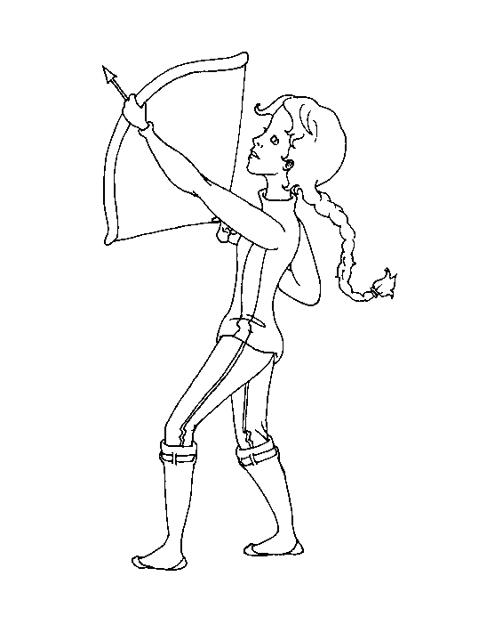
Discuss with your partner and note down in your exercise book: what makes a good first chapter?
Sometimes, when I clean a kill, I feed Buttercup the entrails.
Caring

Slide 3
What do we find out? | Page Number? | Told directly or inferred? | From which character?
The rules of the Hunger Games. The history of Panem. (The Dark Days) How the system of tessarae works.
Think-Pair-Share
How does Collins share information with the reader in the first chapter?
→ Gradually or quickly? → Right from the start or build up? Etc

Slide 4
Homework
Use the internet to find at least 2 facts
that you can include in your letter to an
MP when you type it up on Friday.

